Slide 1

SRI VENKATESWARA COLLEGE OF ENGINEERING&TECHNOLOGY (AUTONOMOUS)
R.V.S NAGAR, CHITTOOR- 517127.(AP)
DEPARTMENT OF COMPUTER SCIENCE AND ENGINEERING (AI&ML)
PROJECT TITLE:AI DRIVEN SYNTHETIC IMAGE DETECTION AND AUTHENTICITY ANALYTICS
STUDENT NAMES
T.DIVAKAR REDDY (22781A33C6)
M.NIRUSHA (22781A3386)
S.ASLAM BASHA (22781A33B4)
S.JAMEEL AHAMED (22781A33B7)
V.MOHAN SAI (22781A33E2)
PROJECT GUIDE:
DR.K.NANDHA KUMAR
DEPARTMENT OF CSE(AI&ML)

Slide 2
AGENDA
ABSTRACT
INTRODUCTION
LITERATURE SURVEY
SYSTEM STUDY
SYSTEM ARCHITECTURE
WORK FLOW SUMMARY
IMPLEMENTATION
APPLICATIONS
FUTURE SCOPE
CONCLUSION

Slide 3
ABSTRACT
The rapid growth in image manipulation has led to an increase in fraudulent vehicle damage claims, creating a strong need for reliable image authenticity verification. This system presents an AI-driven web application that uses deep learning techniques to classify vehicle damage images as real or fake/manipulated. A CNN-based pipeline is employed for data preprocessing, model training, and evaluation, focusing on visual cues such as dents, scratches, cracks, surface deformations, and texture inconsistencies. Before authenticity assessment, a pretrained MobileNetV2 model verifies the presence of a vehicle in the uploaded image. The system generates a binary classification result along with a confidence score and enhances interpretability through feature map visualizations and automatically generated textual explanations. Implemented using the Flask web framework, prediction results are stored and displayed through an interactive dashboard, enabling trend analysis and confidence tracking over time.

Slide 4
INTRODUCTION
The rapid digitalization of insurance and automotive services has increased dependence on image-based vehicle damage assessment, improving efficiency but also enabling fraud through advanced image manipulation and generative technologies. Traditional manual inspections are time-consuming, subjective, and ineffective at detecting subtle digital alterations, while rule-based image processing methods lack robustness across varying vehicle types, lighting conditions, and damage patterns.
To address these challenges, this project proposes an AI-based vehicle damage authenticity detection system using Convolutional Neural Networks (CNNs) to automatically extract visual features such as dents, scratches, textures, and structural distortions. A pretrained MobileNetV2 model first verifies vehicle presence before authenticity analysis. The solution is deployed as a Flask-based web application, delivering real-time predictions with confidence scores, visual explanations, and an interactive dashboard for auditing and analysis, thereby enhancing reliability, transparency, and fraud prevention.

Slide 5
LITERATURE SURVEY
Ref | Authors | Focus Area | Key Contribution
[1] | Phua C. et al. | ML-based Insurance Fraud Detection | Surveyed ML techniques (DT, NN, SVM, clustering); showed ML outperforms rule-based systems
[2] | Krizhevsky A. et al. | Deep CNNs for Image Classification | Introduced deep CNNs with ReLU, dropout, GPU acceleration; foundation for image-based fraud detection
[3] | Kumar S. et al. | Image Processing for Fraud Detection | Used preprocessing and feature extraction (texture, shape, structure) to detect fake insurance documents
[4] | Wang J. et al. | CNN-Based Fraud Detection | Automated feature learning from claim images; achieved higher accuracy than traditional methods
[5] | Monga N. et al. | Image Hashing Techniques | Applied perceptual hashing to detect duplicate/forged images; improved results when combined with deep learning

Slide 6
SYSTEM STUDY
Existing System | Proposed System
Focuses only on vehicle damage identification | Focuses on image authenticity verification (Real/Fake)
Assumes uploaded images are genuine | Detects AI-generated and manipulated images
Relies on manual inspection and basic rule-based checks | Uses CNN-based deep learning automation
Damage detection using models like YOLO, SSD, Faster R-CNN, U-Net | CNN classifier trained on real and fake vehicle images
Limited fraud checks (metadata, duplicates) | Pixel-level artifact and texture analysis
No confidence score or explanation | Provides authenticity score + visual explanations (Grad-CAM)
High human effort, low adaptability | Fast, scalable, and future-ready solution

Slide 7
Overall System Architecture
Modular, layered design for vehicle damage authenticity detection
Integrates UI, deep learning models, explainability, and data storage
Ensures efficient validation, prediction, explanation, and visualization
User
Upload vehicle images
View prediction results
Download analysis reports
Web Interface (Flask)
Handles image uploads and validation
Controls data flow to AI models
Displays predictions and dashboards
Vehicle Validator (MobileNetV2)
Verifies presence of a vehicle in the image
Filters out invalid or non-vehicle images
CNN Authenticity Model
Extracts damage-related features
Classifies images as Real or Fake
Generates confidence score

Slide 8
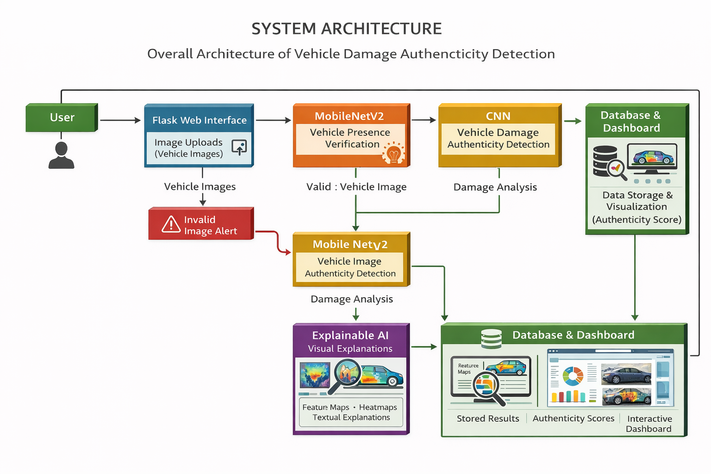
Explanation Engine
Produces feature map visualizations
Highlights influential regions
Provides textual explanations
Database
Stores predictions and confidence scores
Maintains image metadata for auditing
Dashboard
Shows charts and trends
Visualizes historical results
Exports reports in PDF format

Slide 9
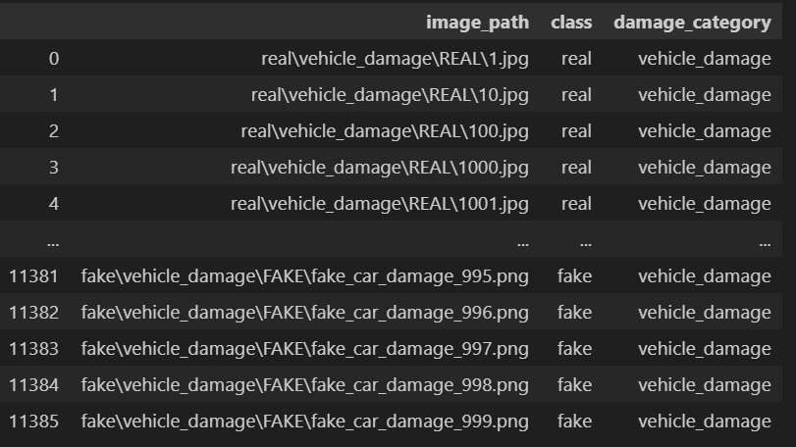
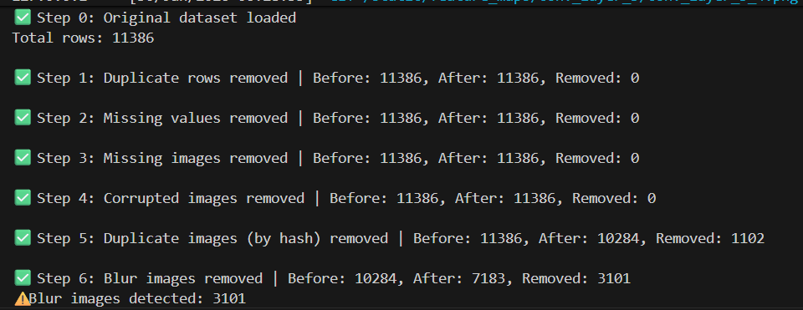
WORK FLOW SUMMARY
Dataset Loading
Collect and load a labeled dataset containing real vehicle damage images and AI-generated/manipulated images.
Organize images into appropriate classes (Real / Fake).
Data Preprocessing
Resize images to a fixed input size required by the CNN model.
Normalize pixel values to improve training stability.
Remove BLUR,,duplicated, corrupted images to ensure data quality.

Slide 10
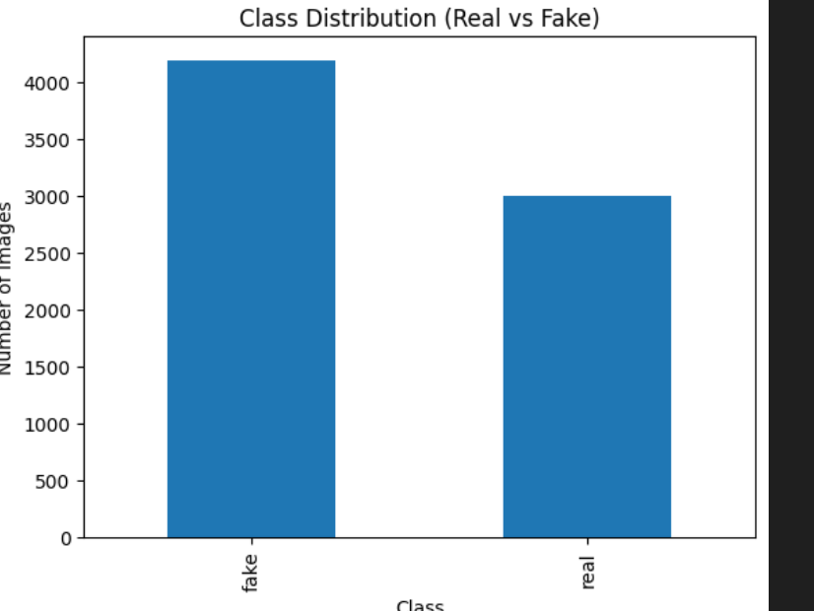
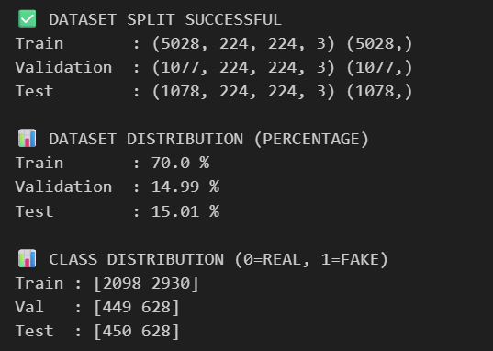
Exploratory Data Analysis (EDA)
Analyze class distribution to avoid data imbalance.
Visualize sample images to understand damage patterns and manipulation artifacts.
Dataset Splitting
Split the dataset into training, validation, and testing sets.
Ensure fair representation of both real and fake images in each split.

Slide 11
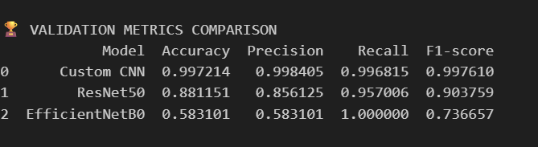
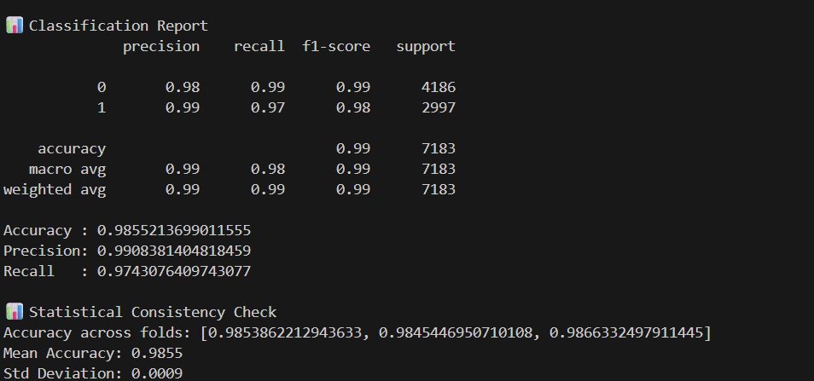
Model Selection and Training
.compare the deep learning models and choose the bestmodel to train the data
Train a CNN-based classification model using supervised learning.
Optimize model using loss and accuracy metrics.
Vehicle Presence Verification
Use a pretrained MobileNetV2 model to confirm that the uploaded image contains a vehicle before authenticity analysis.
Model Evaluation
Evaluate performance using metrics such as accuracy, precision, recall, and confusion matrix.
Validate the model’s ability to distinguish real vs fake images.

Slide 12
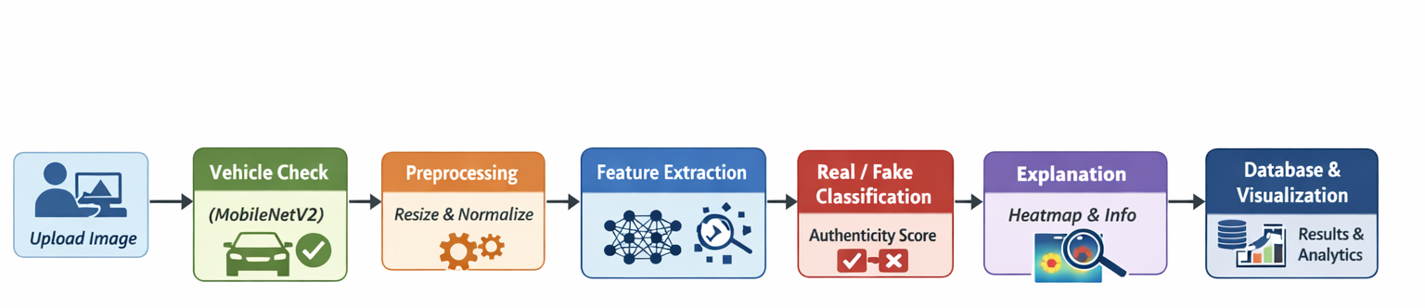
Image Testing (Inference Phase)
User uploads a test image through the web interface.
The system preprocesses the image and performs prediction.
Outputs:
Real/Fake classification
Authenticity confidence score
Feature map visualizations for explainability

Slide 13
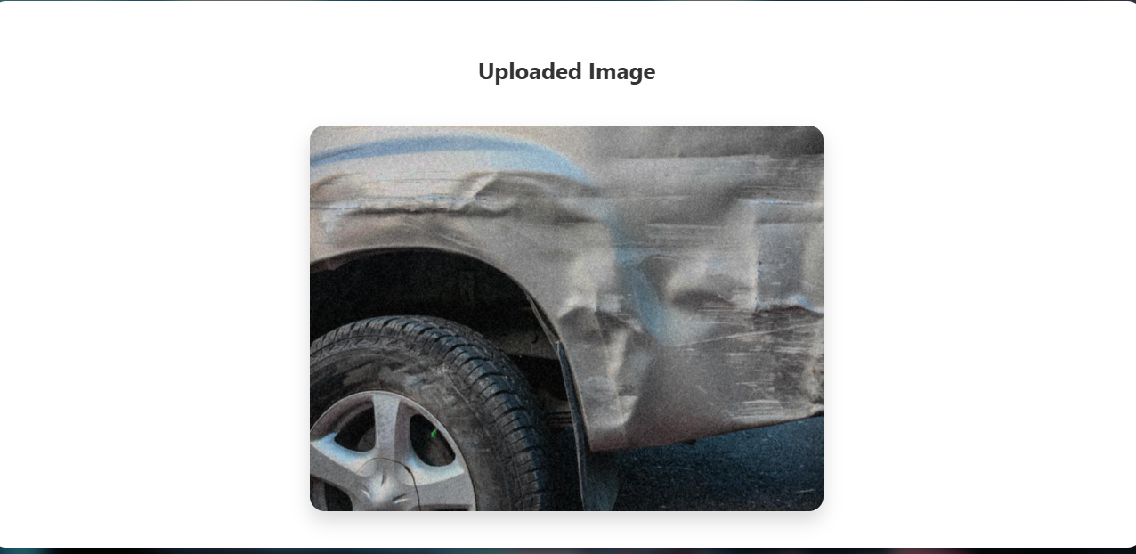
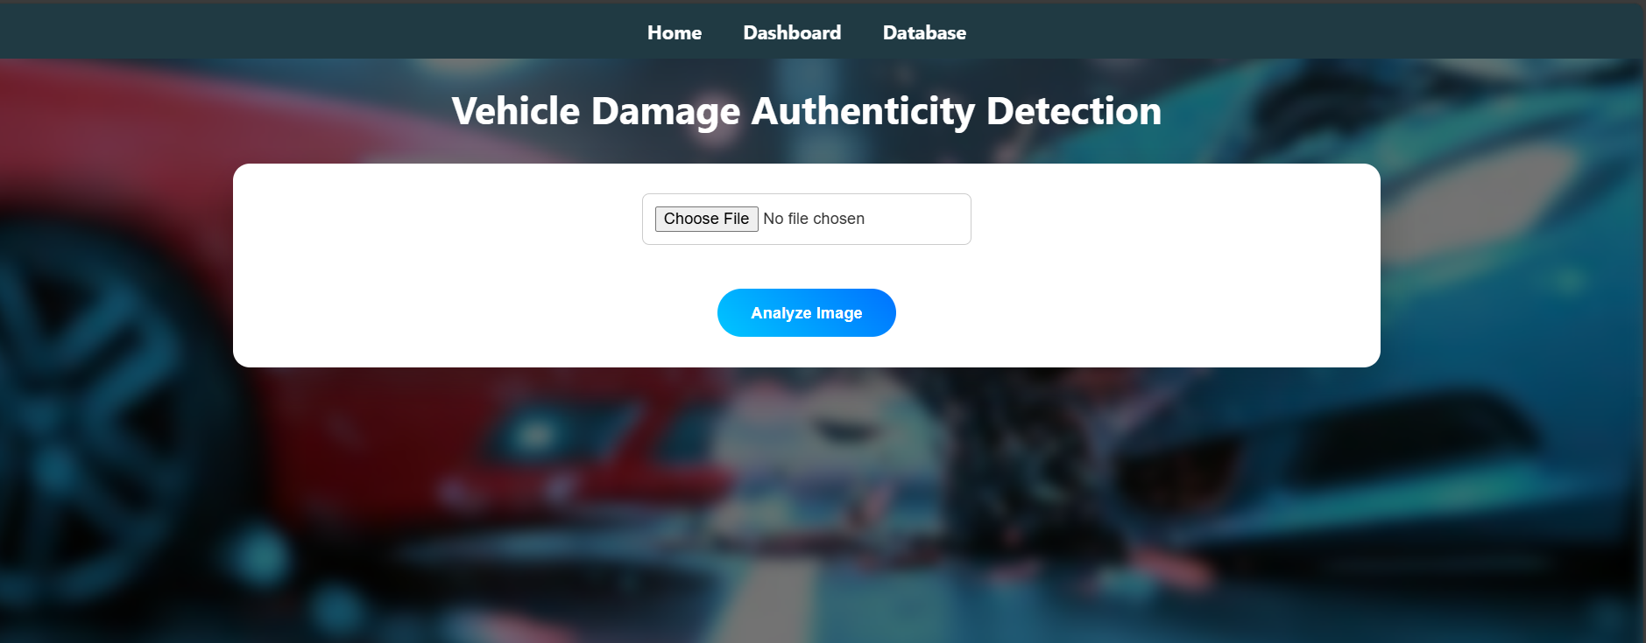
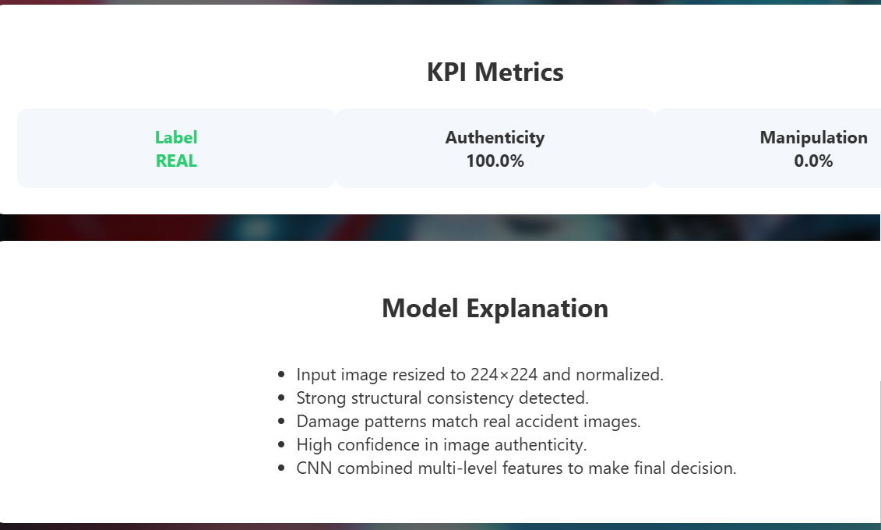
Output Sceenshots:

Slide 14
IMPLEMENTATIONS
The implementation phase converts the proposed design into a functional AI-powered system for detecting vehicle damage authenticity. By integrating image preprocessing, deep learning classification (using MobileNetV2), and explainability mechanisms, the system distinguishes between real and AI-generated or manipulated images. The architecture is built on a modular framework—utilizing Python, Flask, and MySQL—to ensure a seamless flow between the frontend interface and the backend processing. This cohesive approach allows each module to perform specific tasks, from vehicle validation to generating confidence scores, resulting in a scalable and maintainable solution for automated fraud detection.

Slide 15

Technology Stack Used
Programming Language: Python
Deep Learning Frameworks: TensorFlow, Keras
Pretrained Model: MobileNetV2 (Vehicle Validation)
Web Framework: Flask
Database: MySQL
Frontend Technologies: HTML, CSS, JavaScript
Visualization & Explainability Tools: Matplotlib,
Grad-CAM

Slide 16
Applications
Insurance Claim Verification: Automatically verifies damage image authenticity, reducing fraud and manual effort.
Automotive Damage Assessment: Ensures fair damage evaluation during servicing, resale, and warranty claims.
Forensic & Legal Analysis: Assists in identifying manipulated images in investigations and disputes.
Remote Vehicle Inspection: Enables fast, location-independent image-based inspection.
Decision Support: Provides confidence scores and visual explanations to support transparent assessments.

Slide 17
Future Scope
Damage Severity Estimation: Predict damage levels (minor, moderate, severe) to support claim evaluation and cost estimation.
Real-Time & Video Analysis: Enable live video and camera-based vehicle inspection.
Automated Claim Processing: Integrate with insurance systems for end-to-end fraud detection and reporting.
Advanced Explainable AI: Integrate Grad-CAM, saliency maps, and attention mechanisms to highlight manipulated regions.

Slide 18
CONCLUSION
The Vehicle Damage Authenticity Detection system developed in this project demonstrates the effective use of deep learning for verifying the authenticity of vehicle damage images. By using a CNN for real and fake image classification and MobileNetV2 for vehicle presence verification, the system accurately identifies genuine and manipulated images. The CPU-based implementation makes the system cost-effective and easy to deploy without specialized hardware. Image preprocessing, model prediction, and a user-friendly web interface are smoothly integrated to ensure reliable operation. Overall, the system provides a practical solution for insurance claim verification and automotive inspection by reducing fraudulent claims and improving decision-making efficiency.

Slide 19


